Slide 1
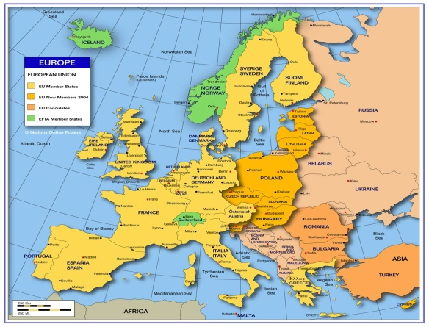
Mercredi, 4 Mars
Objective: To say where we live in Europe.

Slide 2
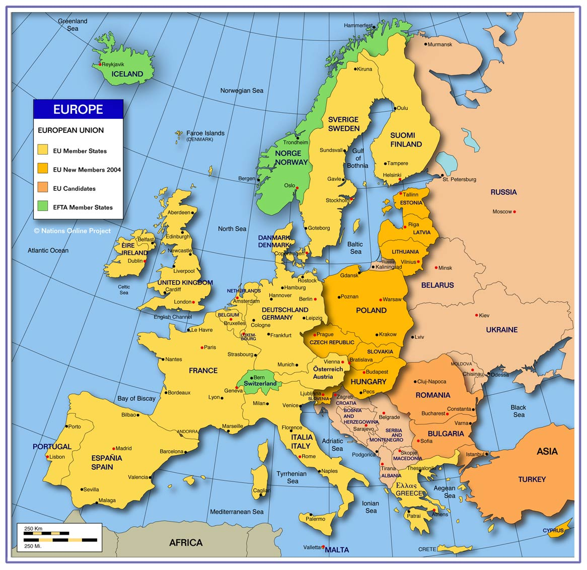

Slide 3


Slide 4
